Slide 1
ADVERSE OUTCOME PATHWAYS
FOR SAFE AND SUSTAINABLE
BY DESIGN APPROACHES
THOMAS EXNER AND PENNY NYMARK
SKIG MEETING 15TH MAY, 2024

Slide 2

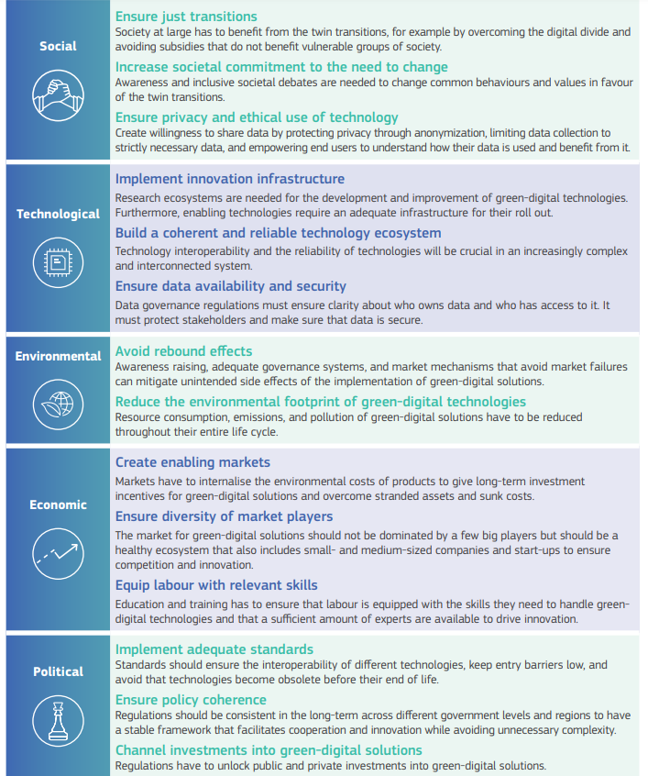
PINK’s ambition to contribute to…
2

Slide 3
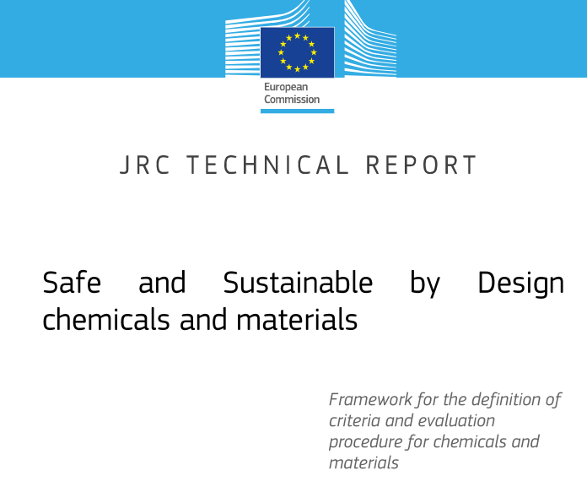
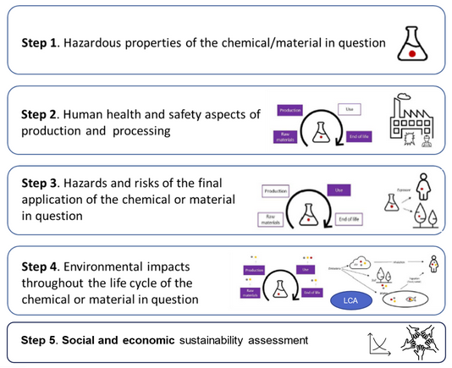
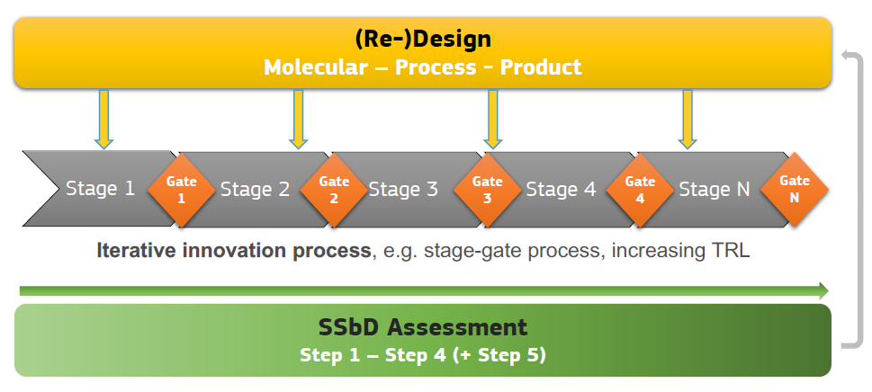
... by implementing industry-ready SSbD

Slide 4
PINK’s high-level objectives
DEVELOP innovative modelling and simulation approaches addressing industrial SSbD needs
MAKE the software accessible to SMEs and industry through the open innovation platform  PINK In Silico Hub - PINKISH
VALIDATE the platform on PINK Developmental Case Studies and Industrial Demonstrators provided by SMEs and large industries
REAL-LIFE industry needs:
  Assessment challenges in biodegradability of co-polymers in aqueous dispersions (long-term toxicity?)
  Long-term aquatic environmental effects of organic UV-blocker in cosmetics and personal care products
Fully IMPLEMENT open science and FAIR principles contributing to establishing a European chemicals and materials data, modelling and software ecosystem
STRENGTHEN knowledge transfer through collaboration and exploiting synergies
BOOST the innovative capacity of SMEs and industry and make them more agile to respond to external and internal influences

Slide 5
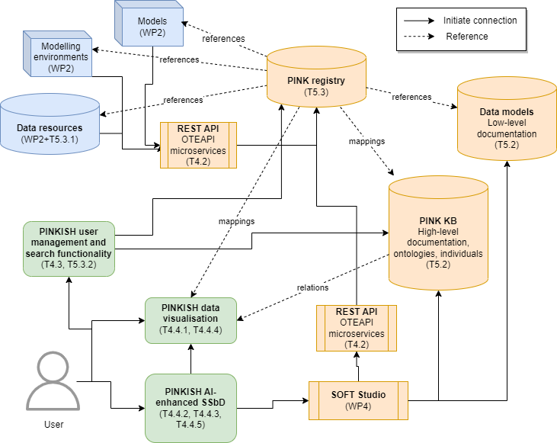
PINK’s innovative modelling
Physics-based multi-scale modelling
Data-driven approaches
  QSA/PR models
  Read-across
  Mechanistic models for biokinetics simulations
  Safe and sustainable production
  Exploratory/prospective LCA
  AOP-driven evidence generation
Decision support and user guidance
→ PINKISH platform
  Integrated Knowledge Graph
  Generative AI with property constraint
  Causal (AI) modelling
Illustration of the architecture of the distributed PINK infrastructure including the independent data and modelling services (blue), the PINKISH components for data visualisation and SSbD decision support (green) and the semantic and technical interoperability framework (orange).

Slide 6

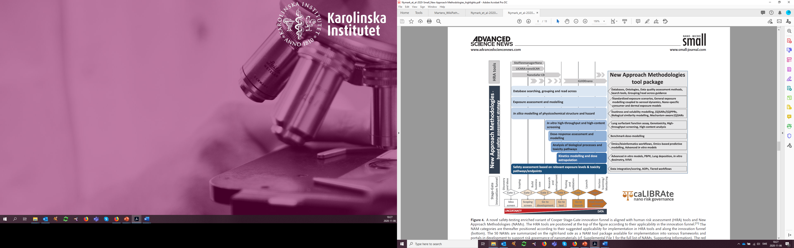
AOPs support data integration across all stages of risk assessment
– from Safe and Sustainable by Design strategies to regulatory requirements
FAIR data
Safe and Sustainable by Design (SSbD) includes safety and sustainability assessments at the earliest possible stage of product and process development to prevent environmental risks and ensure a clean, healthy and safe living environment.
AOPs
Data integration of diverse types of data
Penny Nymark, Karolinska Institute
Nymark P et al. Small. 2020 Feb;16(6):e1904749. http://doi.org/10.1002/smll.201904749
Notes:
AOPs support data integration along the SSbD process – during both data-poor and data-rich stages
PINK aims to enable FAIR data and AOPs for SSbD

Slide 7
The AOP framework needs to be trusted
Trust
Requirements for a knowledge management framework to support trust
Shared Understanding of Methods
Validation
User-centric design
Clear levels of knowledge
Inclusivity of data and methods relevant to regulation
Intuitive visualisations
Contextualisation, comparisons and equivalences
Notes:
But the AOP framework needs to be trusted and much of the trust comes from two areas that we have previously focused on within the so called FAIR AOPs cluster currently led by Clemens Wittwehr
Intuitive visualization and inclusivity of data and methods - both of these support transparency and clarity on the level of uncertainty entailed in the framework

Slide 8
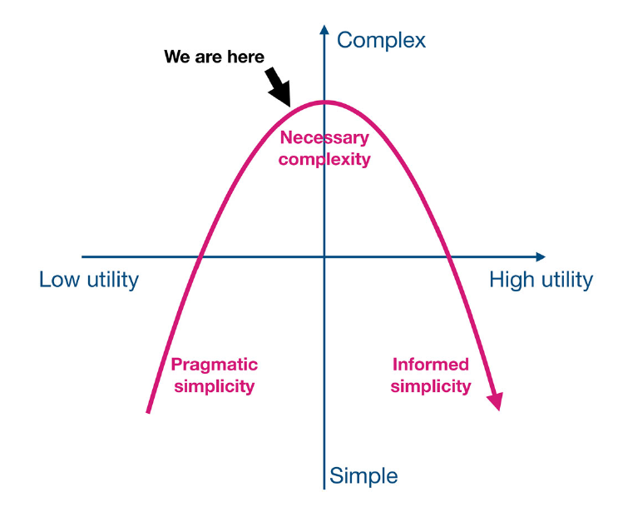
FAIR AOPs support the evolution of the AOP framework from pragmatic to trusted informed simplicity
FAIR AOPs – what is the purpose?
Informed, high utility, simple, and FAIR AOPs support:
- Intuitive visualization
- Inclusivity of data and methods
→ Increased trust
FAIR AOPs take us here
Knapen D. 2021 https://doi.org/10.1002/etc.5205
Wittwehr et al. 2024 https://doi.org/10.14573/altex.2307131
Penny Nymark - Karolinska Institute
Notes:
So in PINK we also have a strong interest in FAIRifying AOPs in order to move from pragmatic to informed simplicity
Figure originally developed by Dries Knapen and that we in the FAIR AOPs cluster have used to demonstrate the need for FAIR AOPs
FAIR AOPs take us to the level of high utility informed simplicity which increases visibility, allows for inclusion of data/methods and improves trust

Slide 9
>THANK YOU!
1 Contact name
2 Institution name▌
_
WWW.PINK-PROJECT.EU

